Slide 1

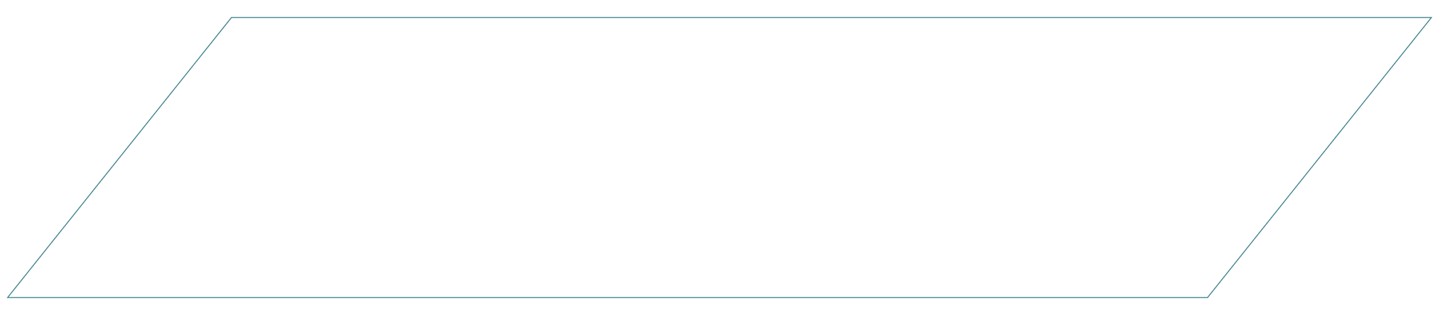
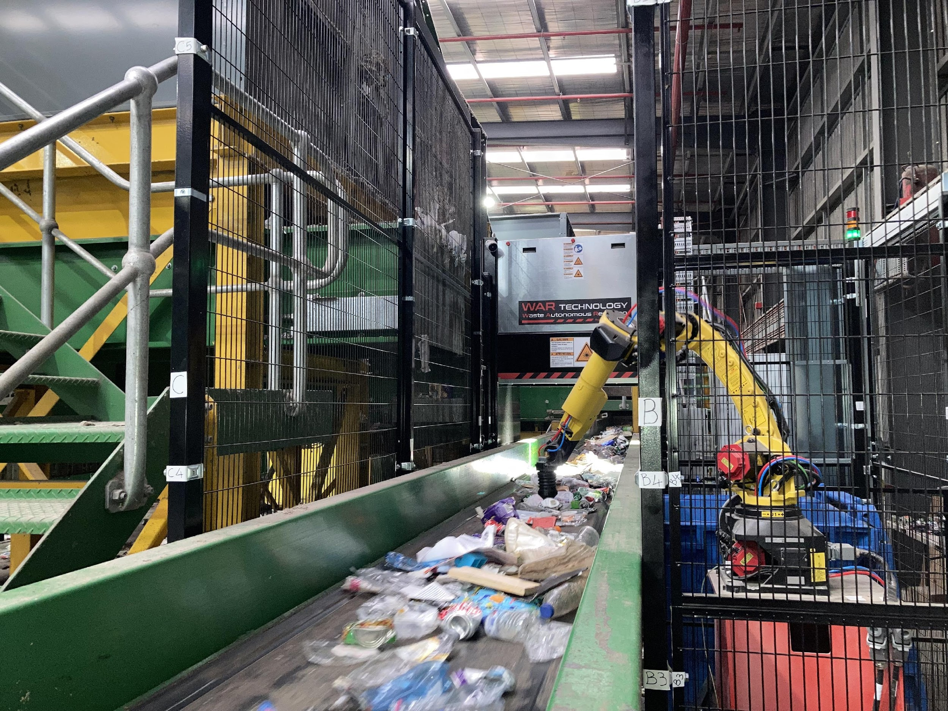
VALUE PROPOSITION:
ROBOTIC SORTING LINE
Presented to: Jelle Sernee
Synvase
Hanson
Mai 26th , 2025
CONFIDENTIAL

Slide 2

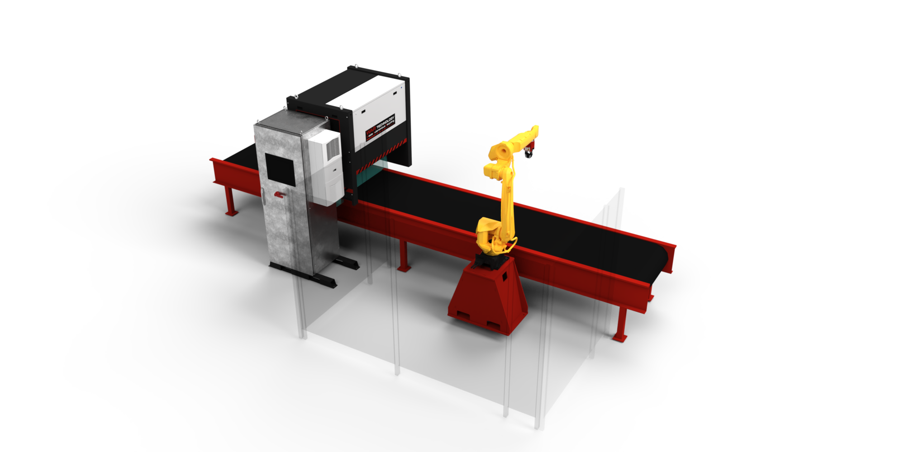
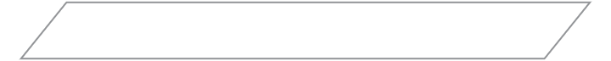
APPLICATION OVERVIEW
This proposal is designed to provide your organization with a preliminary solution of 1 robotic arm. The final configuration of the robots and bins are yet to be confirmed.
PRELIMINARY LAYOUT DESIGN (1-ARM SYSTEM)
Auto generated iso view
CONFIDENTIAL – PAGE 3/7

Slide 3
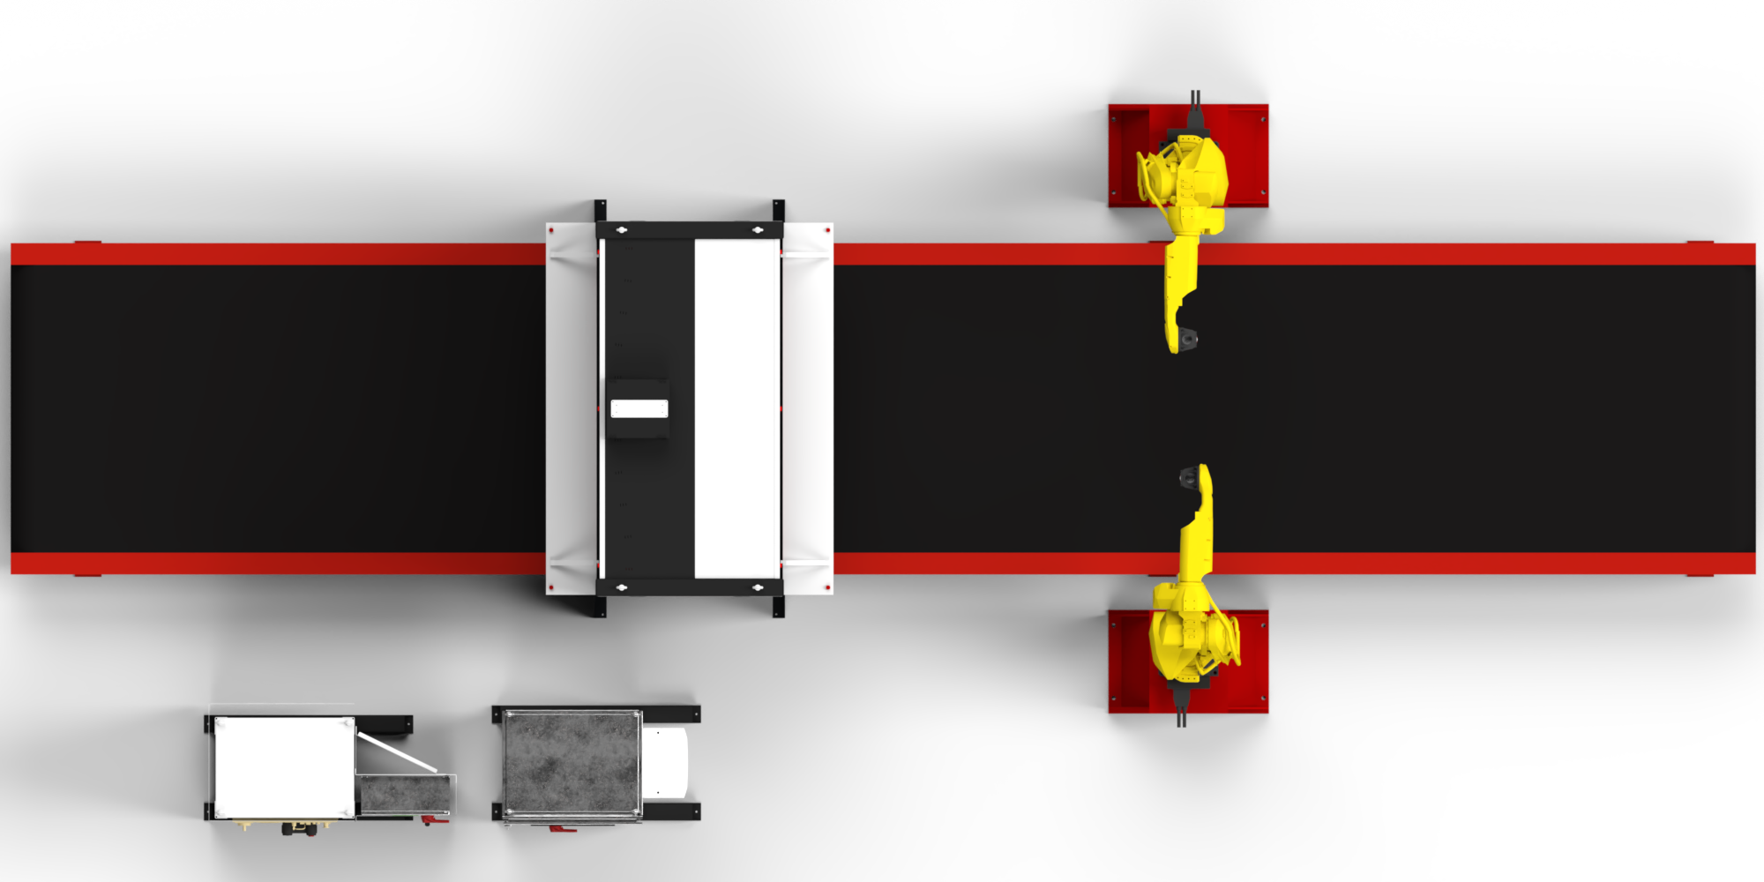
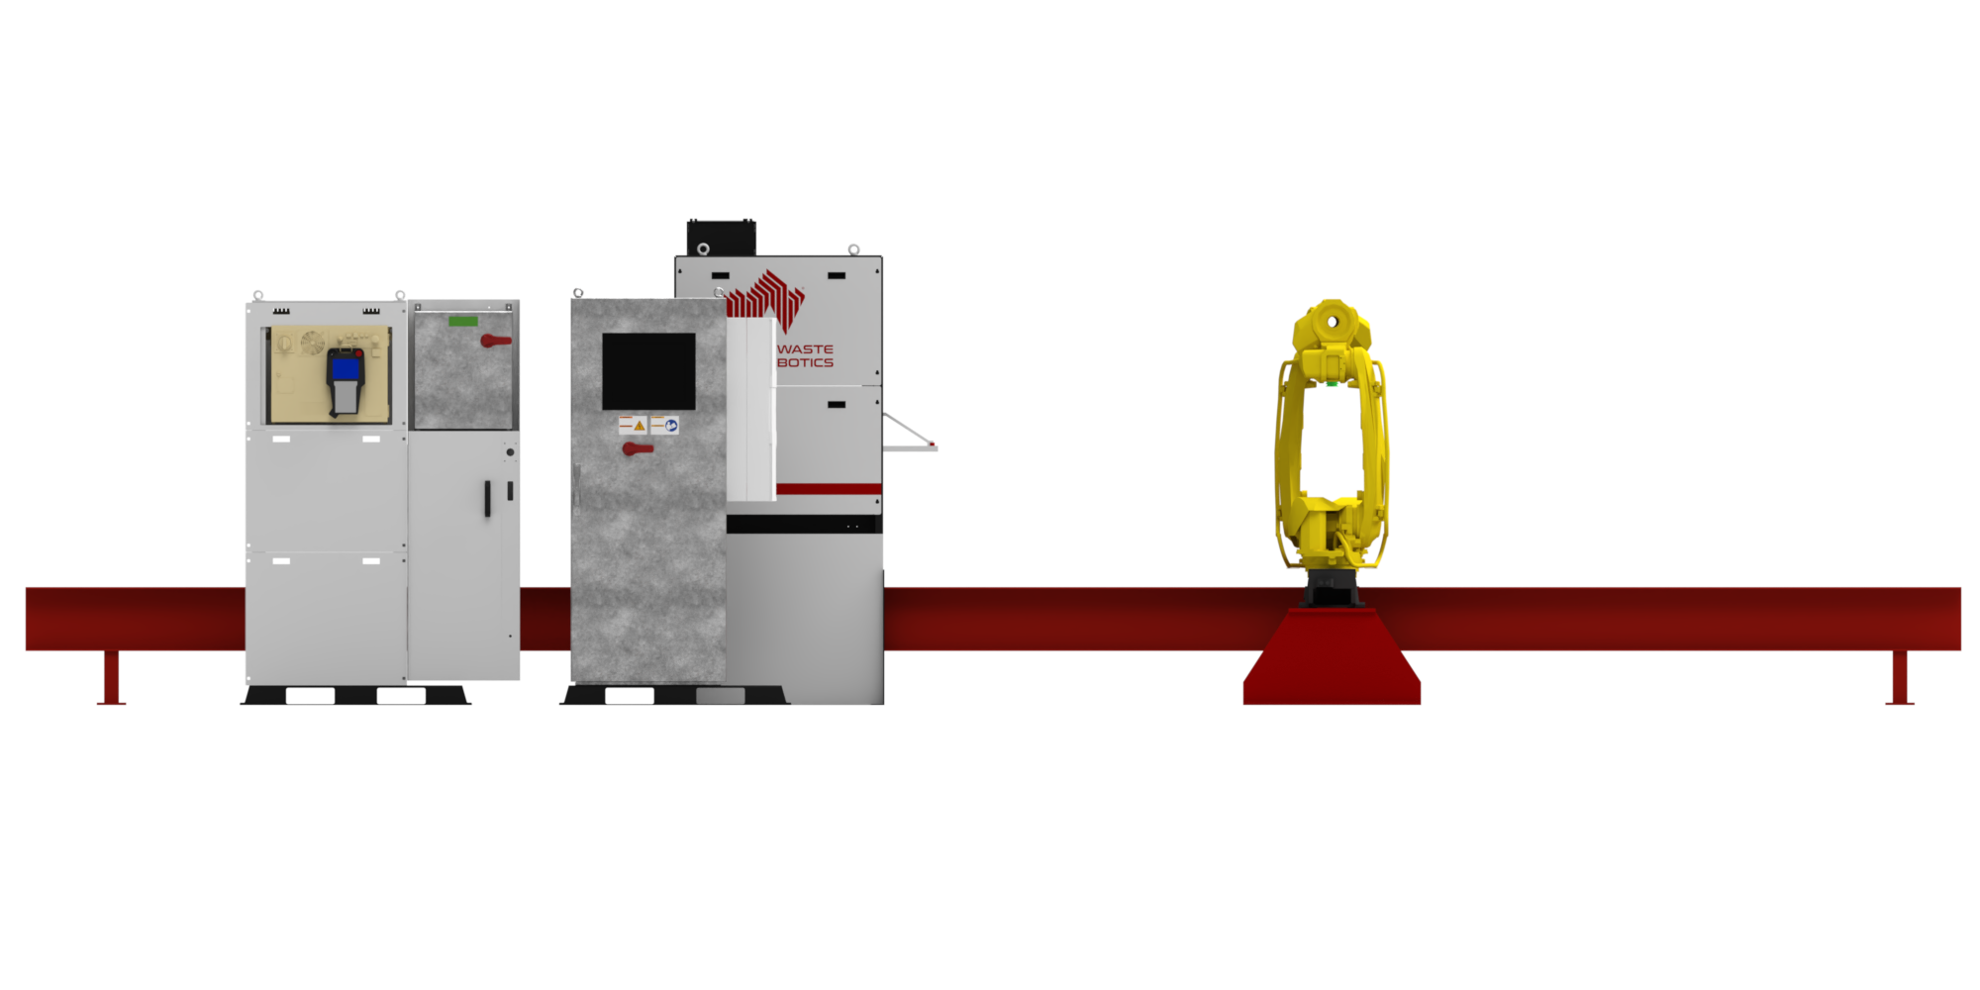
LAYOUT OVERVIEW (1-ARM SYSTEM)
Safety Fencing
Material Stabilization Zone
600
1800
3400
2100

Slide 4
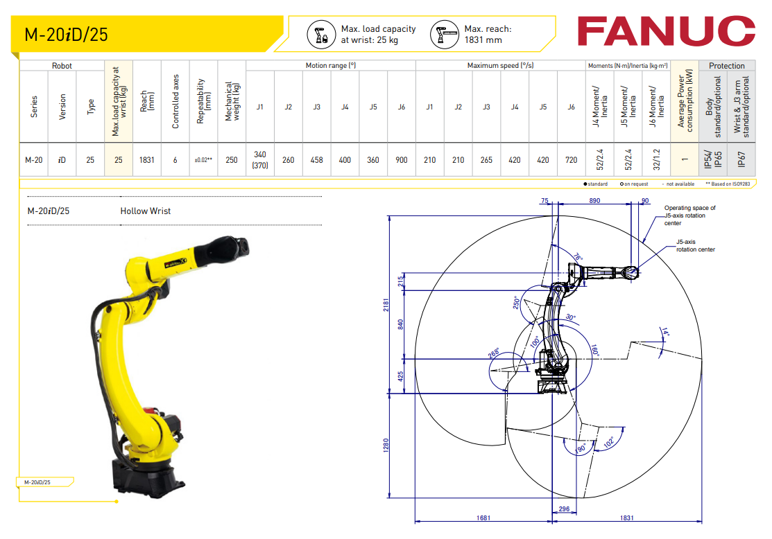
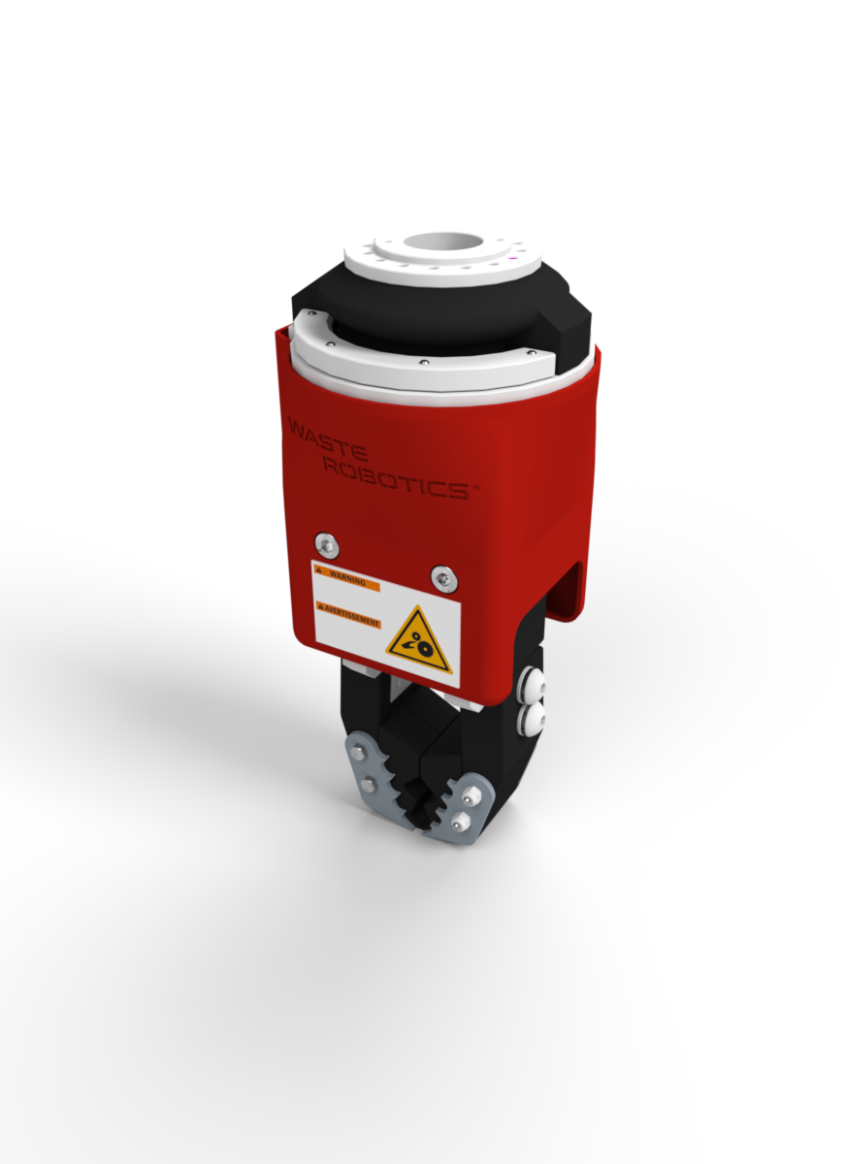
ROBOT ARMS MODEL
Auto generated Robot model spec sheet
GRIPPER MODEL
Auto generated gripper model ender
Model: PinchR
Max Object Weight: Up to 5kg
CONFIDENTIAL – PAGE 5/8

Slide 5
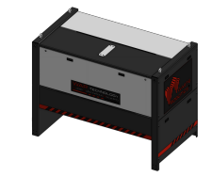
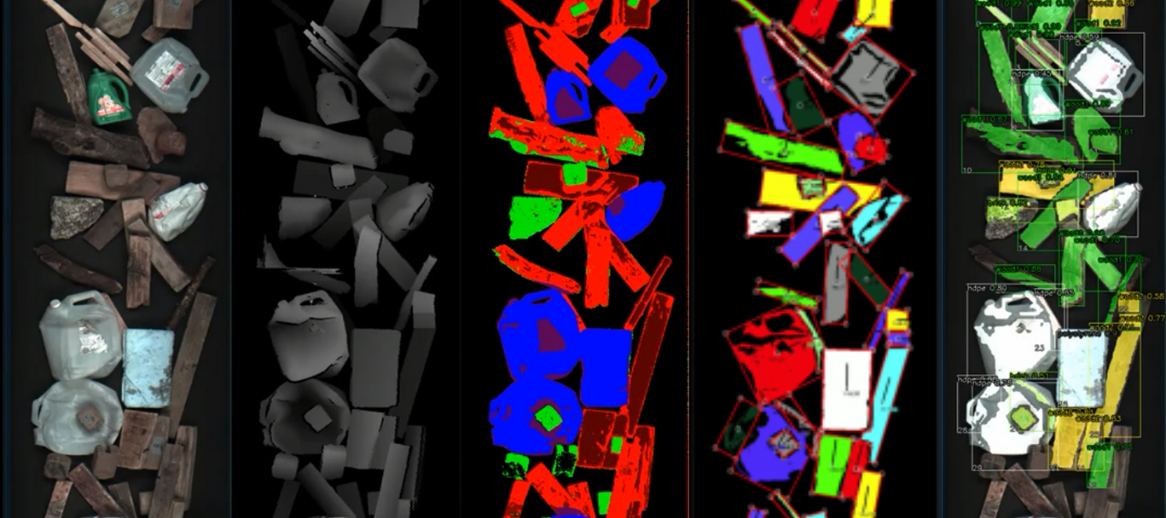
ROBOT VISION SYSTEM SENSOR FUSION
Deepvision
COLOR
3D
AI
CONFIDENTIAL – PAGE 6/8

Slide 6

SPECIFICATIONS:
- Up to 30 picks per minute (1 robot)
- Maximum object weight per robot: 5 kg
Robots operating conditions: 5°C to 45 °C
BUDGET
Includes
1 robots Fanuc M-20iD-25
1 robot base
1 AI gripper
- Robot Vision System (RGB and 3D cameras)
AI Software licence
AI custom training
Factory pre-assembling and testing
Shipping to Germany
- Installation supervision on site
- Security perimeter
Excludes
- Mechanical installation
- All modifications required on current equipment to integrate the robotic system - Electrical hookup in client’s facility
- Total input power 16 kVA (average
consumption: 6kW)
- Internet hookup in client’s facility (up/down 100 Mbits/sec)
- Compressed air hookup in client’ facility
(total air consumption: 283 L/min) - Taxes, customs and/or duty charges
BUYING PRICE*
Robotic sorting system
€ 340 000 EUR
Additional robot arm
€ 90 000 EUR
* Prices may vary due to exchange rates, inflation, and integration engineering. Valid for 30 days.
DELIVERY
24-30 weeks (to be confirmed at order time)
We should have a option in the form to have a additionial robot with pricing
CONFIDENTIAL – PAGE 7/8

